Slide 1
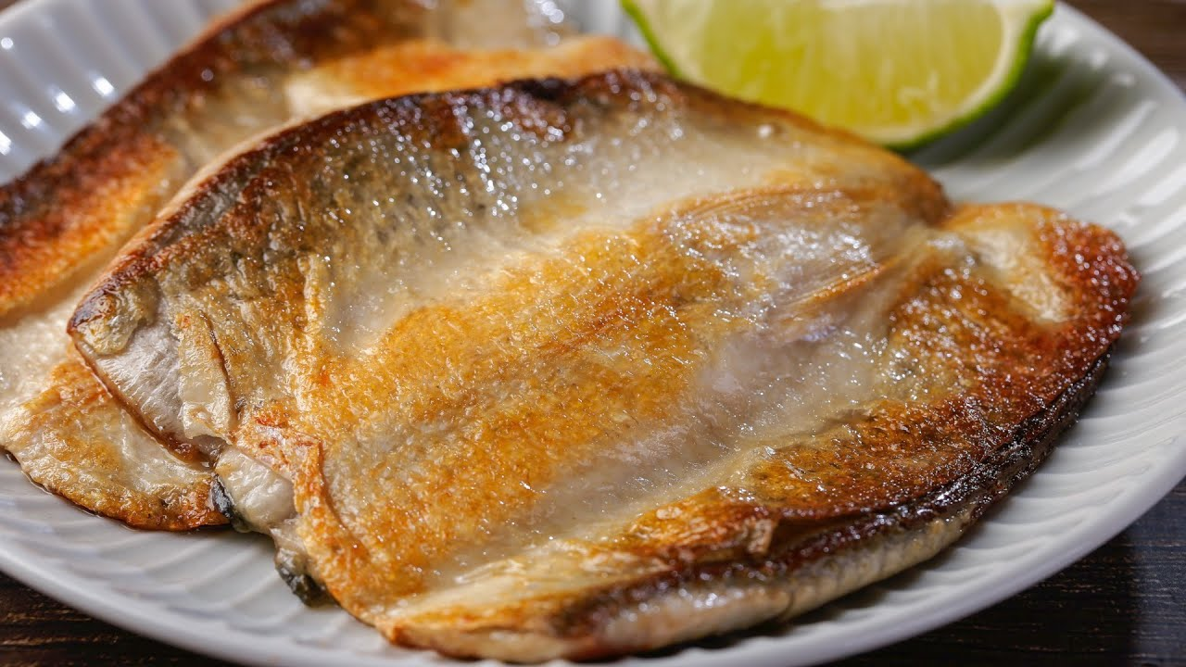
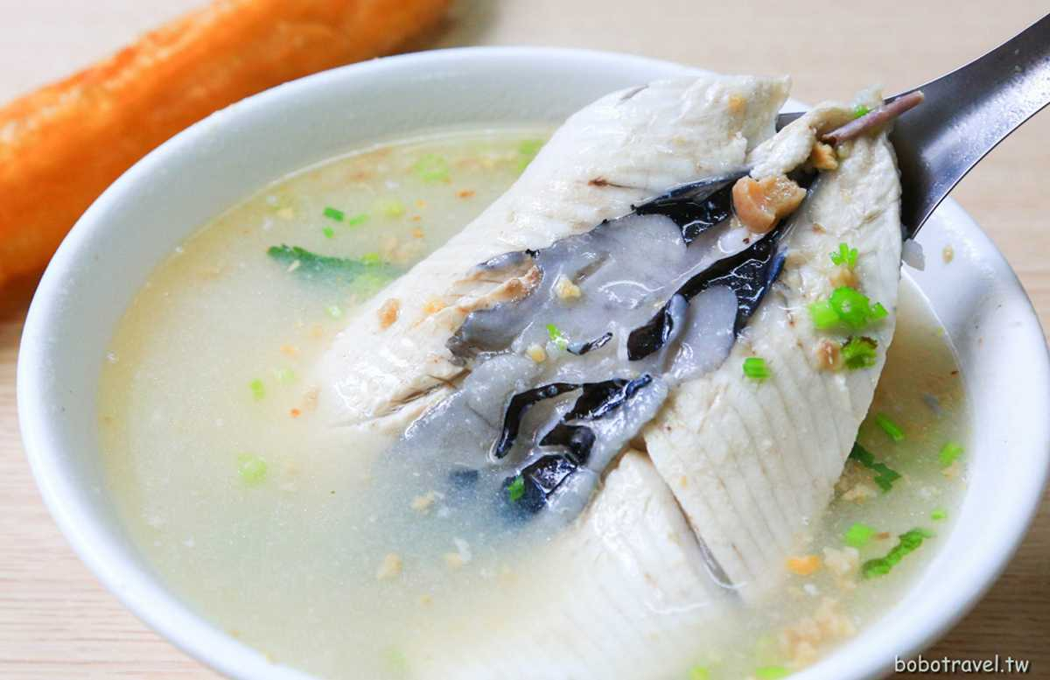





Taiwan Xiao-Chi
Differ between Northern and Southern Xiao-Chi
Northern Xiao-Chi
Southern Xiao-Chi
Shopping List
Milk Fish Cuisine
Milk Fish is a common fish in southern of Taiwan. From fish head to fish tail, Taiwanese could cook it variously, but no other cuisine is more famous than milk fish congee.
Milk fish congee is a popular breakfast in Tainan city (a south city in Tainan), however, for northern people, milk fish is too greasy to eat it at morning. We usually eat milk fish congee as midnight snack.
Recipe
Combine water and rice in a large pot, add salt and dashi no moto. Bring to a boil, reduce heat to low. Simmer uncovered for 20 minutes, stirring occasionally
After 20 minutes add chopped pieces of fish and cook until just done (just a few minutes
Add it to shopping list!
Taiwan Xiao-Chi
Northern Xiao-Chi
Southern Xiao-Chi
Differ Between northern and Southern Xiao-Chi
Shopping List

